Slide 1


USA Trauma Database
Group 2
Britain James, Jahnavi Godavarthi
Prabhudatta Mohapatra, Swetha Uppula
Date: 03/14/2023

Slide 2

Agenda
USA Trauma Database Overview
Database Priority Features
Business Rules
Conceptual Model
Relational Model
Physical Database Design
Requirements Review
Future and Research Scope
Conclusion

Slide 3
USA Trauma Database History
The first computerized trauma database developed in 1969 in Chicago, Illinois.
The American College of Surgeons established the Database in 1989.
First report was released in 2001.
Now the largest and most widely used trauma database in the United States

Slide 4
USA Trauma Database Overview
“The more we know, the more we share, the more patients can recover to full health. It’s that simple, that profound.”
It’s ultimate mission is to provide the trauma patients with most advanced and cost effective healthcare.
The Trauma Database is a standardized database for healthcare research, also know at NTDB (National Trauma Database)¹
It is used for tracking data from hospitals across the country.
Participating hospitals receive many benefits.

Slide 5
USA Trauma Database Business Rules
Database records each trauma incident, not the patient involved
A person having multiple trauma would appear multiple times in database
To comply with HIPAA² rules patient name and home address is not recorded
Diagnosis code, Procedure code, and Comorbidity Code is collected from CMS³ (Center for Medicare and Medicaid Services)
Above codes are recorded in ICD-10 (International Classification of Diseases) format
Vitals information is stored in a separate table to maintain additional level of security and control access to avoid identification of any PHI (Protected Health Information)

Slide 6
USA Trauma Database Priority Features
Facility (Hospital/Clinic) information
Patient Demographics involved in an incident
Vitals recorded after admission to Emergency Department
Diagnosis done by physician
Pre-existing comorbidities
Procedure(s) done by physician
Discharge Status
Payment Information

Slide 7
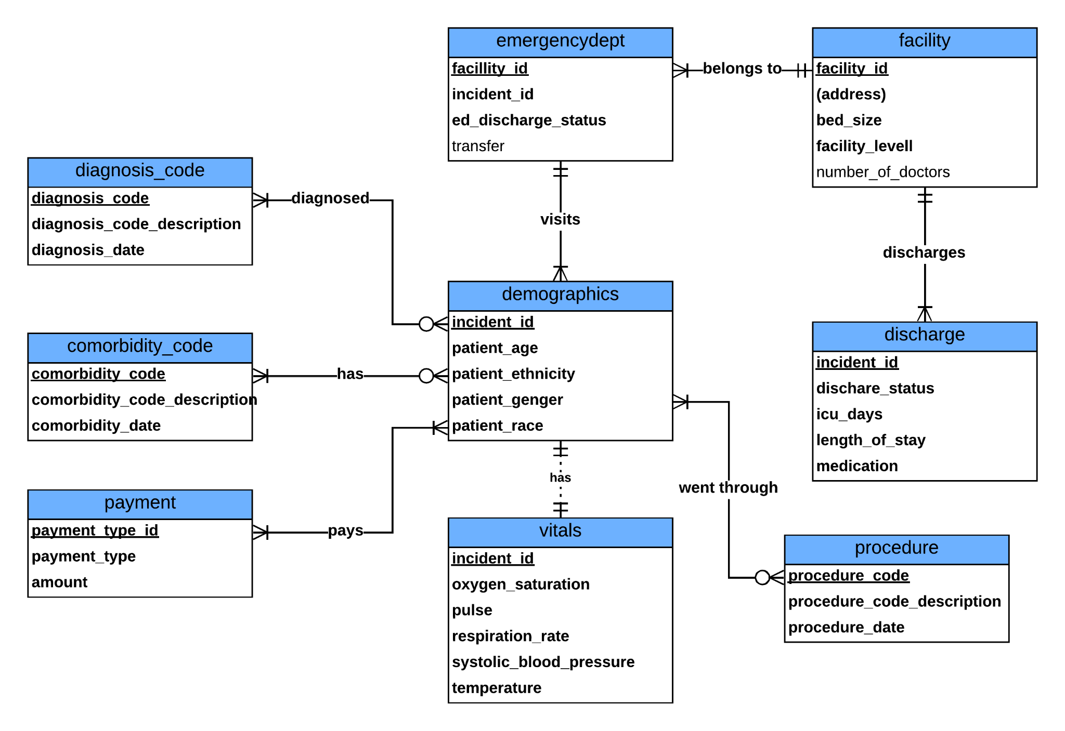
USA Trauma Database Conceptual Model
Demographics table is the center of the model
Most of the tables have (optional) many to many relationship
Each incident related information can be recorded following the business requirements

Slide 8
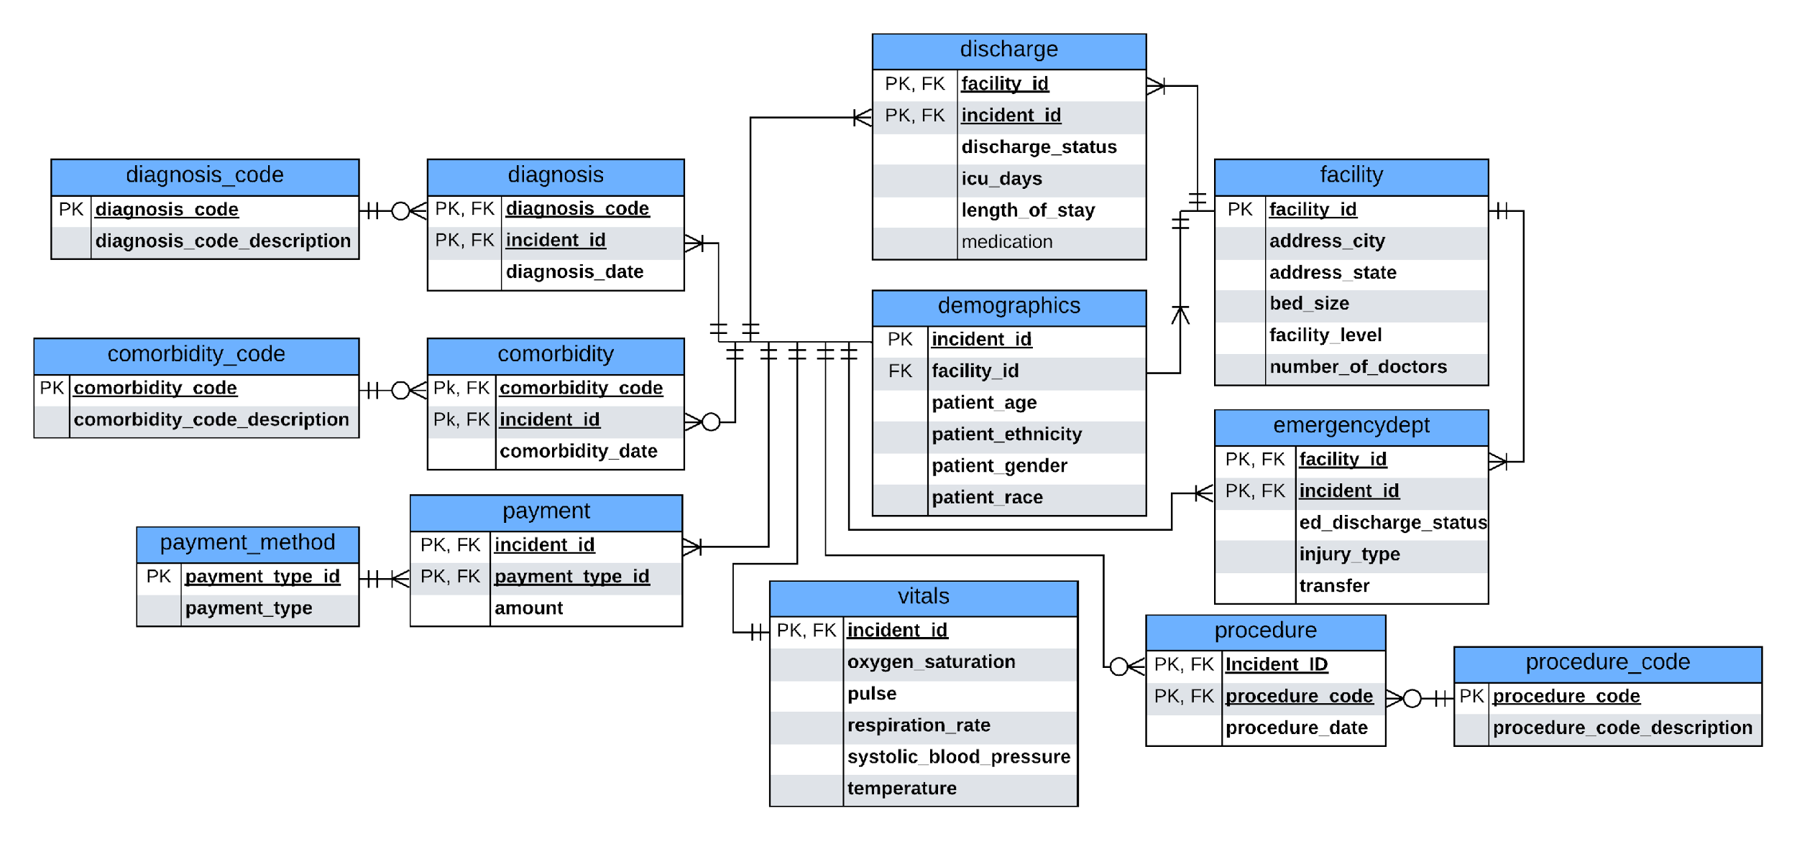
USA Trauma Database Relational Model

Slide 9
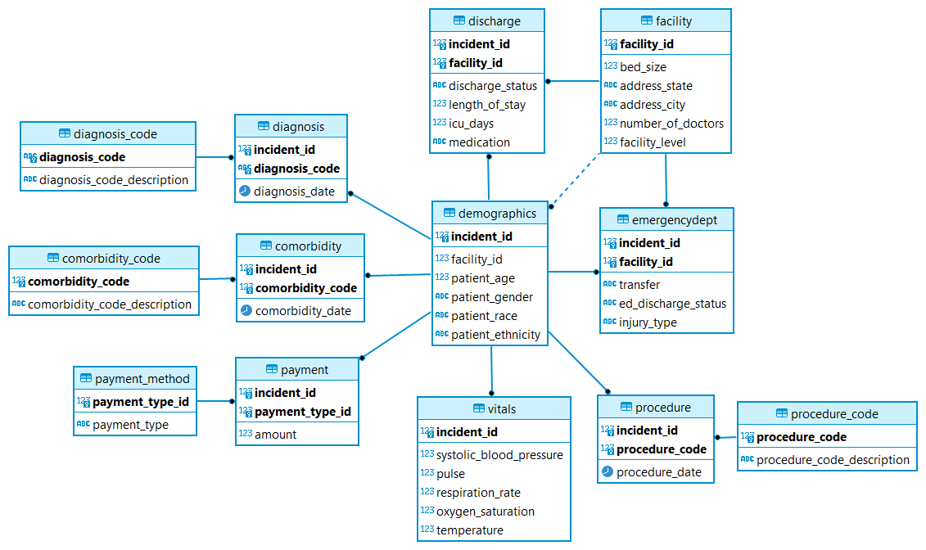
USA Trauma Database Physical Model

Slide 10
USA Trauma Database Primary Data setup
Primary Tables
Secondary Tables
Commands
Data Types
Tools
Demographics
Discharge
Facility
Vitals
Emergency Department
Diagnosis
Procedure
Comorbidity
Payment
Comorbidity Code
Diagnosis Code
Procedure Code
Payment Method
DROP
CREATE
INSERT
SELECT
UPDATE
MODIFY
DELETE
Numeric
CHAR ()
Date
Decimal
Smallint
DBEAVER
POSTGRES
SQL

Slide 11
USA Trauma Database Requirements Review
Current Functionality
Trauma data for each patient involved in the incident is available
Pre-existing conditions, demographics information along with the vitals and injury type are made available for the patient involved in an incident
Patient diagnosis and procedure details are made available.
Patient transferred from another facility along with the medication and comorbidity data are recorded
Discharge details such as length of stay, discharge status along with the payment amount and method (e.g., Medicare, Medicaid, Insurance) has been recorded

Slide 12
USA Trauma Database Requirements Review
Completed Tables
106 incidents have been recorded
Incidents are from 27 different cities from 18 different states of USA
Patients involved in these incidents have been treated at 27 different facilities
There are 26 incidents which have been transferred from a different facility
Mortality status for 14 people is deceased or expired during discharge
25 different types of comorbidities (Charlson Comorbidity Index) have been tracked as per CMS standard

Slide 13
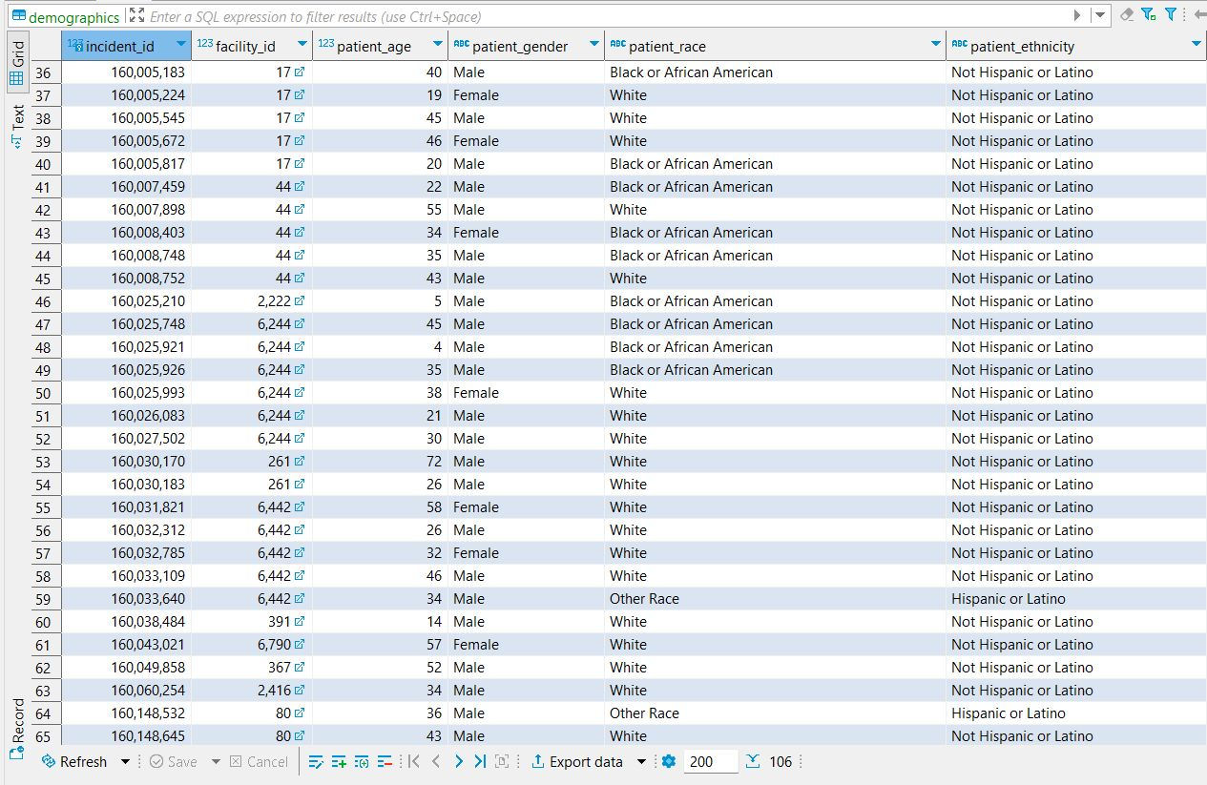
USA Trauma Database Conclusion Demographics

Slide 14
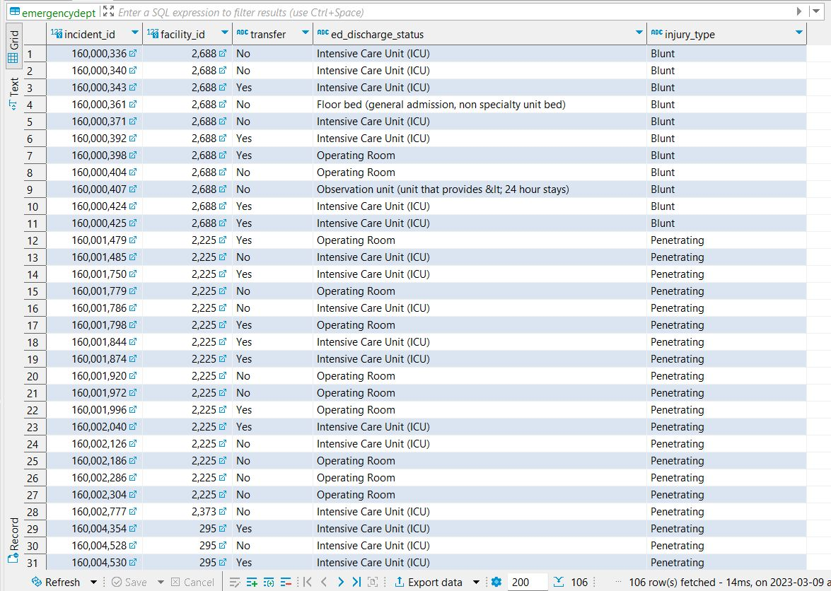
USA Trauma Database Emergency Department

Slide 15
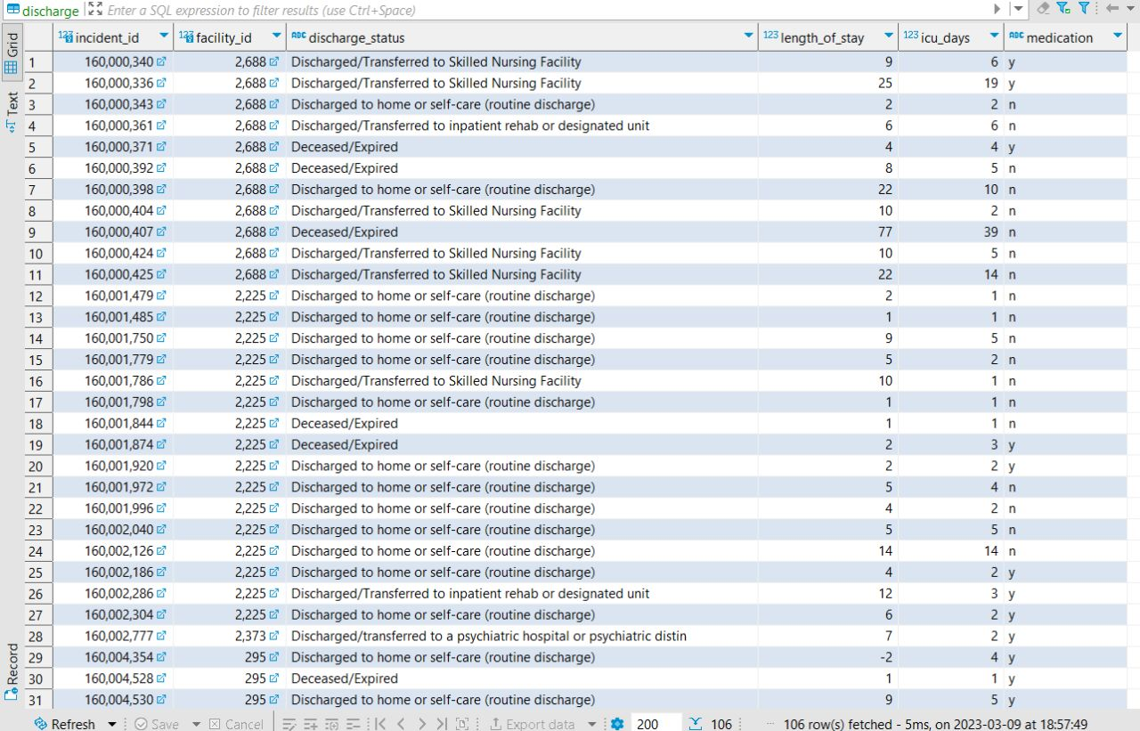
USA Trauma Database Discharge

Slide 16
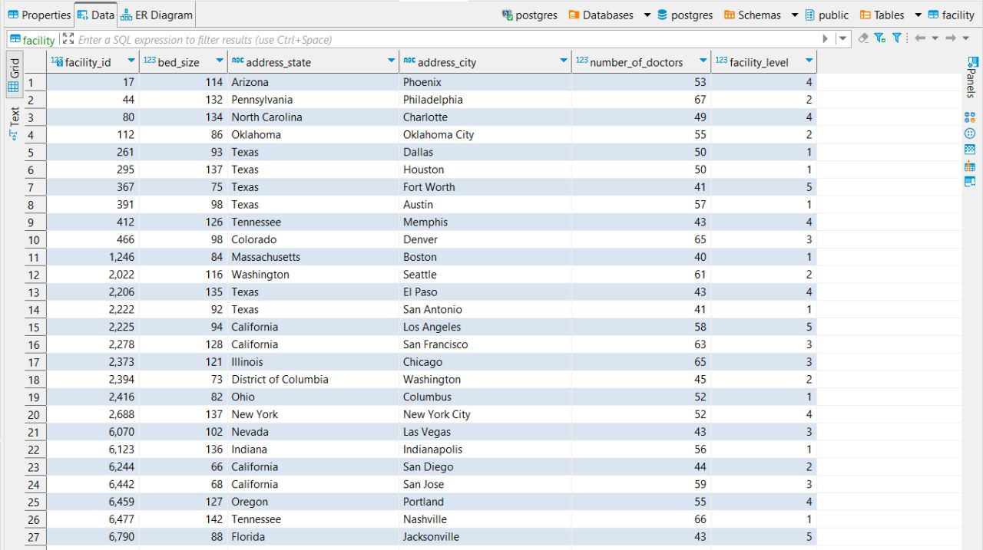
USA Trauma Database Facility

Slide 17
USA Trauma Database Research Scope
USA Trauma Database provides standardized, high quality, and nationwide integrated data for high impact healthcare research
Age, race, gender and ethnicity – Precision Medicine Research
Facility, State and City – Facility and Regional difference in Healthcare
Injury Type, Diagnosis, and Procedure – Analyze different types of treatment
Vitals and Discharge– Patients response to medications and treatment
Payment Details – Cost effective/Low value healthcare

Slide 18
USA Trauma Database Future Scope
Tracking persons involved in an incident in all facilities (transferred cases) to maximize coverage
Recording Trauma Severity by using AIS⁴ (Abbreviated Injury Scale)
Adding complications information during a procedure
Tracking usage of any protection device during an incident
Recording mode of transport and time taken to reach a facility
Incident location and cause of injury
Employment type and status of the person involved in the incident

Slide 19
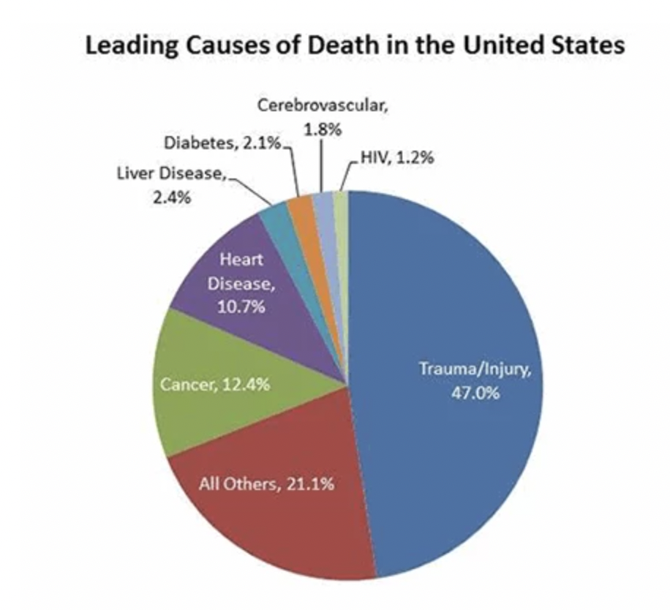
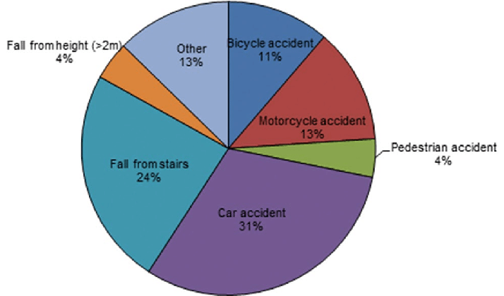
USA Trauma Database Trauma Statistics
Trauma statistics graphs from Pie chart displaying the categorization of trauma patients , Pie chart of Trauma Statistics analysis

Slide 20
USA Trauma Database References
National Trauma Data Bank. ACS. (n.d.). Retrieved March 10, 2023, from https://www.facs.org/quality-programs/trauma/quality/national-trauma-data-bank/
(OCR), O. for C. R. (2022, December 6). Hipaa Home. HHS.gov. Retrieved March 10, 2023, from https://www.hhs.gov/hipaa/index.html
Home - Centers for Medicare & Medicaid Services. CMS. (n.d.). Retrieved March 10, 2023, from https://www.cms.gov/
Wikimedia Foundation. (2022, July 1). Abbreviated injury scale. Wikipedia. Retrieved March 10, 2023, from https://en.wikipedia.org/wiki/Abbreviated_Injury_Scale
Trauma statistics graphs from Pie chart displaying the categorization of trauma patients , Pie chart of Trauma Statistics analysis

Slide 21

Questions & Discussion

